Slide 1
Introduction to AR with Unity
Natasha Mangan

Slide 2
Focus of this Module
Augmented Reality (AR)
Designing for AR
Techniques for AR Games

Slide 3
What you need
A Passable Decent Mobile Device
Mobile phone or tablet
Or a Webcam
Recommended to use Andriod Devices over iOS

Slide 4
Some options for completing the device requirement
Have your own device
Borrow from someone
Have a group member which has a device
Use Vuforia instead (webcam)

Slide 5
What is AR?
Augmented Reality is technology that:
Blends the real and fictional world together
Has real-time input and output
Tracks objects through a virtual interface in a real-world environment

Slide 6
Who uses AR?
Cultural Heritage and Archaelogy
Architecture planning
Piloting and driving advanced vehicles
Virtual support
Games
Our focus ☺

Slide 7
AR Examples from your Everyday Life

Slide 8
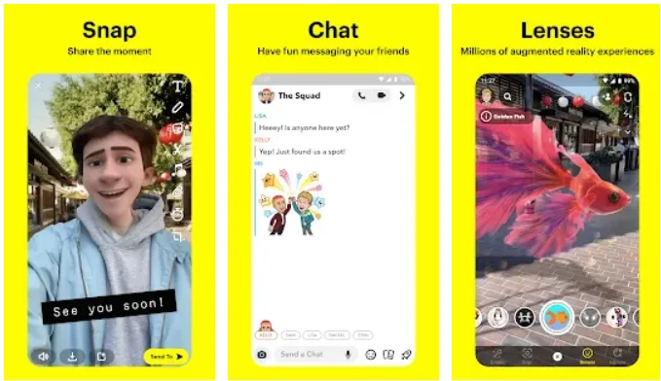
Snapchat
Before TikTok there was snapchat
Overlays filters using facial recognition to manipulate the real-world

Slide 9
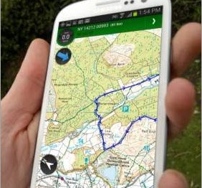
Adventures – ViewRanger trail map
Overlays data and navigation onto trails in different countries.
Other Examples:
The AR[T] Walk
HoloMaps
HUDWay AR

Slide 10
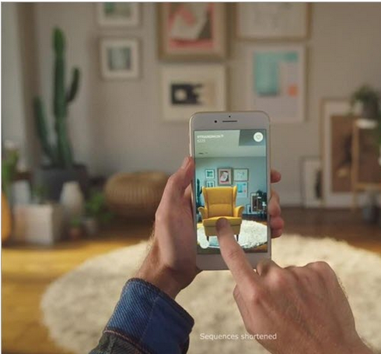
IKEA Place Lowe and Delux Visualizer
This app helps to remodel your rooms and visualize home products right at the store without having to buy them first.
Other examples:
Magicplan App
ARKit
AR Sketchwalk

Slide 11
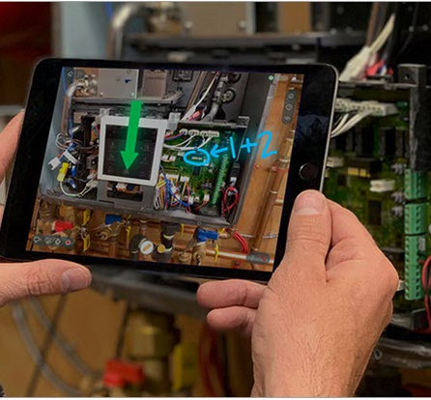
Manufactoring -> Worklink by ScopeAR
Do remote installations, repairs, and maintenance guided by experts without having the experts traveling to the location.

Slide 12

Manufactoring -> Porche AR Glasses
https://www.youtube.com/watch?v=NSfzsw4eCXI

Slide 13
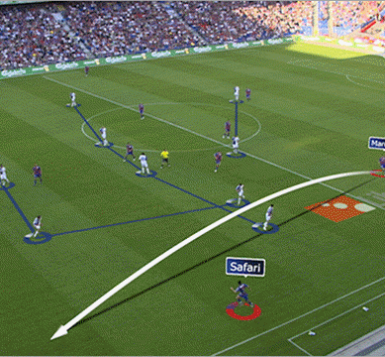
Sports – AR Sport
App combines AR technology with fantasy sports for more immersion of the players inside the games.
Other Examples:
Google Glass
Nike’s AR
BlendAR

Slide 14

Pokemon GO
The popular game released in 2016
A multi-player AR game traveling and discovering hidden Pokemons on real-world map locations.
Other Examples:
Angry Birds AR: Isle of Pigs
Jurassic World Alive
Five Nights at Freddy’s AR

Slide 15
What encompasses AR?

Slide 16
Reality on your Phone
Portable
Built-in cameras
Local Orientation through accelerometers

Slide 17
Benefits of AR
Permits you to annotate the real world
It allows for:
Provision of context specific information
Visualisation without permanence
Collaboration and integration of viewpoints
Vastly improved accessibility in modern life

Slide 18
Drawbacks of AR
Still Experimental
Not perfect just yet
Costly performance
Integration with complex environments is messy
Our devices are still not powerful enough
Extraordinary tools arent really there

Slide 19
AR -> VR -> MR
Termonology is often confusing and used interchangeably
For this module we will consider virtual continuum
One is very real while the other is very virtual
AR sits somewhere in the middle
VR + AR = MR (Mixed Reality)

Slide 20
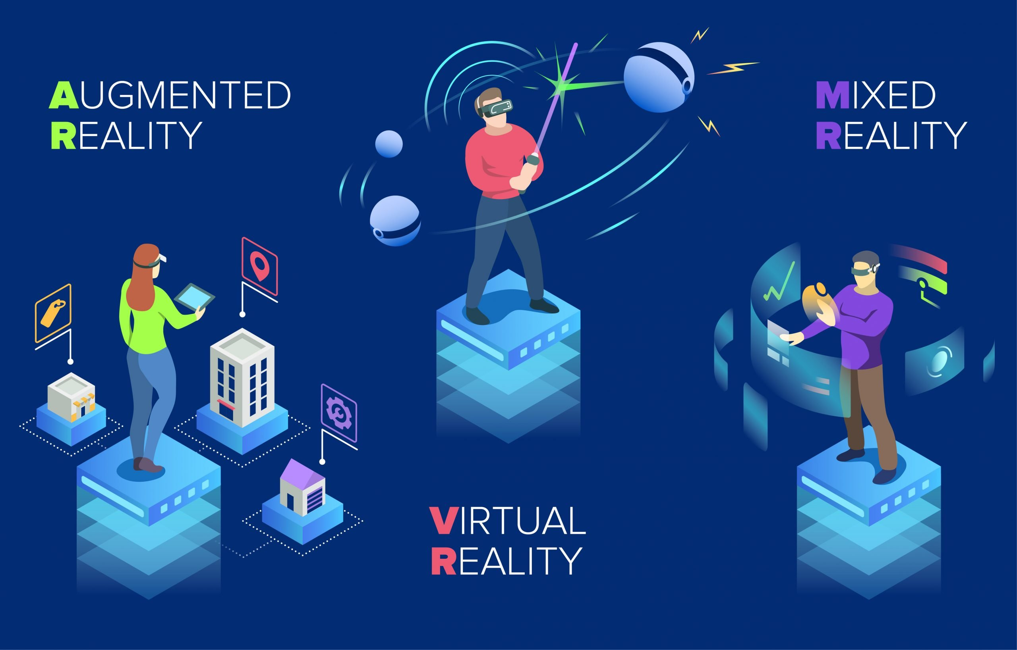

Slide 21
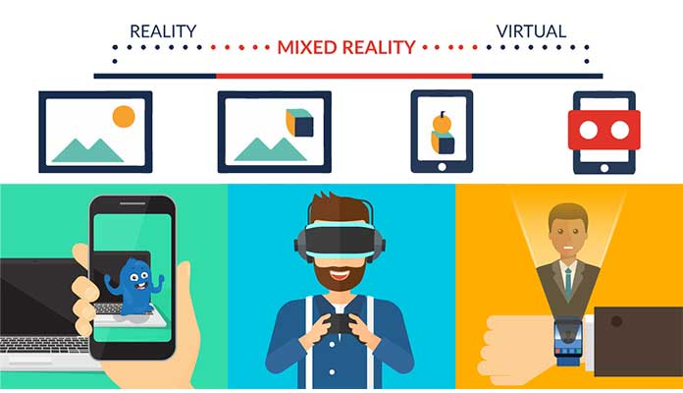
https://sangari.co.za/the-difference-between-virtual-reality-augmented-reality-and-mixed-reality/

Slide 22
Definitions of AR, VR, MR
Virtual reality (VR) immerses users in a fully artificial digital environment.
Augmented reality (AR) overlays virtual objects on the real-world environment.
Mixed reality (MR) not just overlays but anchors virtual objects to the real world.
https://sangari.co.za/the-difference-between-virtual-reality-augmented-reality-and-mixed-reality/

Slide 23
Unity AR Technology

Slide 24
Technology Stack
AR Foundation
However, this is an abstract framework.
It defines an API, but it does not handle the implementation.
It always has to work in conjunction with a concrete implementation of its API.
Android based phones -> Google’s AR Core framework.
Apple based phones -> AR Kit.
If you have a different kind of phone, let that be a lesson about trying to evade conformity.
Get in touch and we can sort something out, if you haven’t found a solution with your group

Slide 25
Technology Stack
Vuforia
Vuforia isn’t the ‘official technology’ of the module.
Vuforia though is your only option if you really want to run AR apps but don’t have a supported device.
Can be tweeked to work with this module, but it can be sticky.
Works with Webcam
Note that the example programs from the course will not work with it.
without tweeking involved –> lots of it

Slide 26
Phone = Output Device
Most handheld devices won’t be set up to immediately work with a Unity AR project.
So you’ll need to open them up a little, in software, to make it happen.
For those with Android phones, you’ll need to install an ADB bridge.
Instructions for this are available on the Canvas.
For those on iOS, you’ll be working on your phone via Xcode.
Again, instructions available on the canvas.

Slide 27
The Big Picture

Slide 28
Two major concepts
World Tracking
Reference points

Slide 29
Other necessary components
Sessions
AR Camera
Plane Detection
Light estimation
Raycasting

Slide 30
Sessions
Core building block of an AR scene
Control the life-cycle
We use them like any other game object – drag and drop
Responsible for:
Handles the connection -> Real world to virtual representation
Handles real-time detection of the environment
Handles translations between Local, World, and Session space
Handles the scale to fit all AR content to a devide-wide context

Slide 31
AR Camera
Is the centre of the action
Attached to AR Session Origin
Works on the principle of SLAM
Simulataneous Localization and Mapping
Contains the Pose Driver
POSE – Position and Orientation
Responsible for:
Viewport and Translation of movement
Handling Light Estimation

Slide 32
Plane Detection
Process of continuous discovery
Constant examining of camera feed to identify graphical elements that give insight into the environment
The camera, with limited depth perception, works out where the walls and surfaces lie
Highly contingent on processing power of your device
Need the AR Plane Manager object to do this
Added to AR Session Origin

Slide 33
Plane Detection
Works on several principles:
AR Camera Manager consistently searching for points
Identifies them as anchor clouds
Extrapolation from existing planes
Key point detection
Consolidation
Takes overlapping planes and simplifies them into single planes

Slide 34
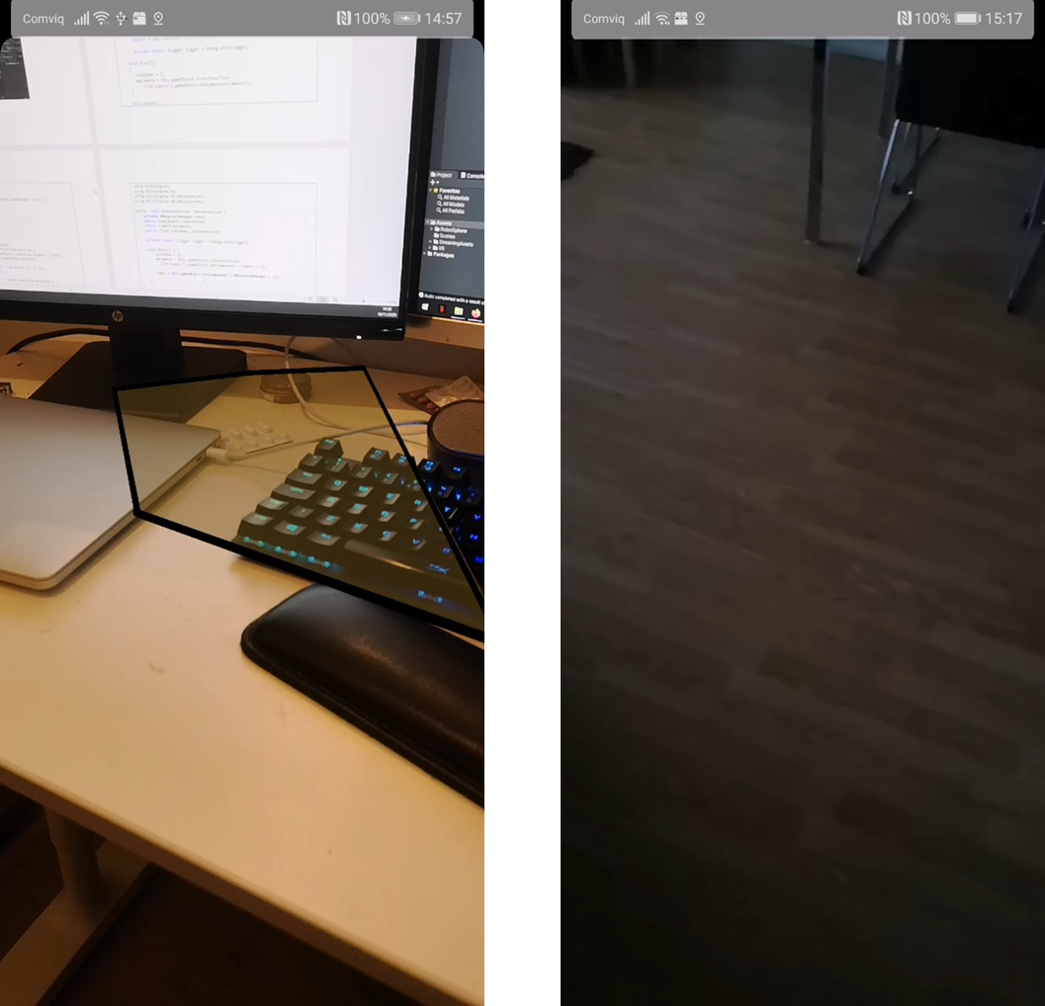
Plane Detection

Slide 35
Light Estimation
Modern phones have a light sensor built into them.
handles things like automatic dimming or brightening of the screen.
It also feeds some information into the broader light estimation process of AR Foundation.
Building a light model of a real-world environment is more complex.
Done through the same kind of image analysis as is done for plane detection.
Scans pixels to work out a baseline level of light.
This is used to work out how to best light the objects that are represented within an AR scene.
Light + shadow = vital, to making realistic objects in a scene.

Slide 36
Light Estimation
Works on as single key principle
It’s an average of the intensity of pixel data drawn from the current frame + some buffering thrown in.
Need to look into light estimation
It does not automatically factor in light sources from the real-world!
Picking the right shader for the right object is important here, and AR Foundation comes with a number of these.
Mostly it’s handled via the AR Camera Manager component.

Slide 37
Light Estimation
We can track several key properties applied to a directional light source to handle lighting in an AR scene.
Brightness – the estimated illumination in a scene
Colour temperature
Colour correction
Main light direction
Light colour
Light intensity
Spherical harmonics
Not all of these will be available on every device.
Change these as the scene updates to give some dynamic lighting to the assets you have in your Unity environment.

Slide 38
Raycasting
a Physics function that projects a Ray into the scene, returning a boolean value if a target was successfully hit.
When this happens, information about the hit, such as the distance, position or a reference to the object's Transform, can be stored in a Raycast Hit variable for further use.
Uses an invisible line set in a direction from the centre of the camera
On hit we gain access to a list of objects in the scene it intersects with
Used to find nearest/farthest planes for positioning AR assets or to identify a targeted object for interaction

Slide 39
Building our first AR project

Slide 40
Lets build up the concepts
First you’ll need to add your teck stack
ARFoundation + {ARCore | ARKit}
Can do this with aided support
the canvas document -> Setting up your device for AR
We will start from the basic AR scene
A scene
An AR Session
An AR Session Origin

Slide 41
The First AR Project
Inputs
Touch 2 fingers -> spawn an instance of an asset
Touch 1 finger -> apply force and cause the object to fly away
Scripts
RobotBehaviour
Handles spawning/instantiation
Handles Both Inputs
Handles cooldowns
Light Estimation

Slide 42
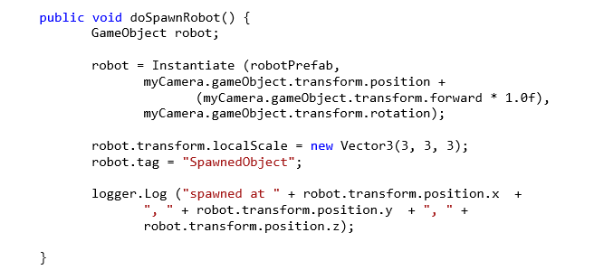
RobotBehaviour
SpawnRobot

Slide 43
RobotBehaviour
SpawnRobot
Problematic
We need to use raycasting and plane detection to do this
Once we find the plane, we use POSE to instantiate our asset
We also need to decide on Anchoring points
If its a plane –> ARAnchorManager.AttachAnchor(plane, anchor);
If not -> ARAnchorManager.AddAnchor(anchor); (depreciated to AddComponent<ARAnchor>() )
Then set as parent to our spawned asset

Slide 44
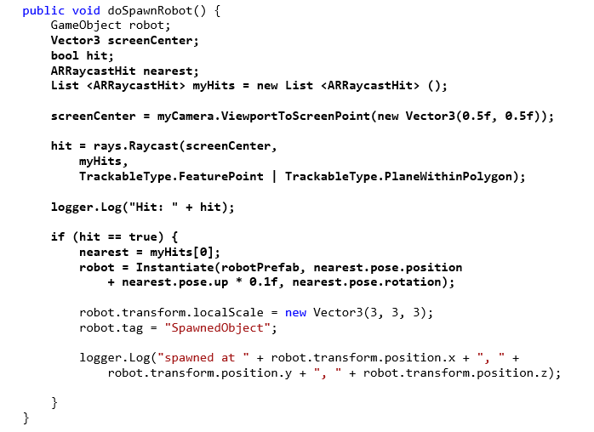
Addition of raycasting and plane detection

Slide 45
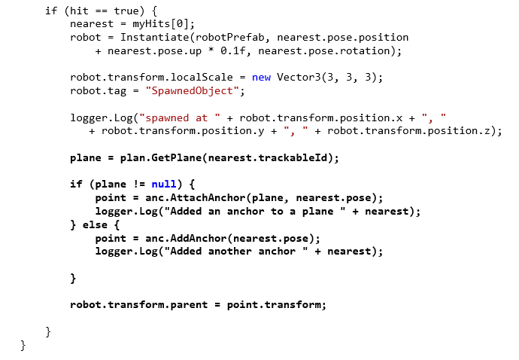
Addition of anchoring

Slide 46
Handling the Inputs
We need to switch between two methods of raycasting
AR
Unity regular raycaster
Buts its similar to finding a plane

Slide 47
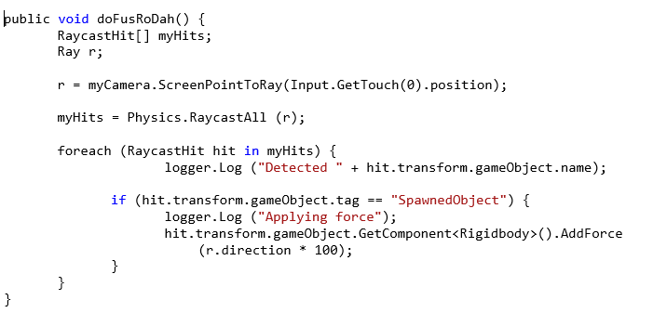
Addition of movement

Slide 48
Some things are asset will need
Our asset is going to need two components added.
A collider
Use a box collider for ease of interfacing, but make sure it’s scaled to the asset
A rigidbody
For responding to forces.
When this is in place, we follow a simple process:
Get the screen point indicated by a ray
Raycast it forward
If it hits an object, check to see if it’s a spawned object
We do this via a tag (SpawnedObject)
If it hits a spawned object then add a force in the direction of the ray.

Slide 49
But we are missing something
Light estimation!!
We will do this by adding a script to the direction light
Every frame we update the light settings with information received
We will relfect the light model that the mobile is generating -> can do this is more ways than this.

Slide 50
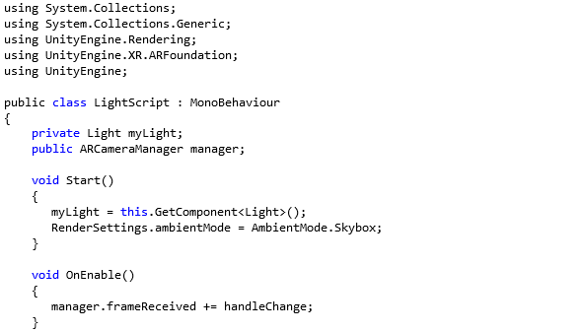
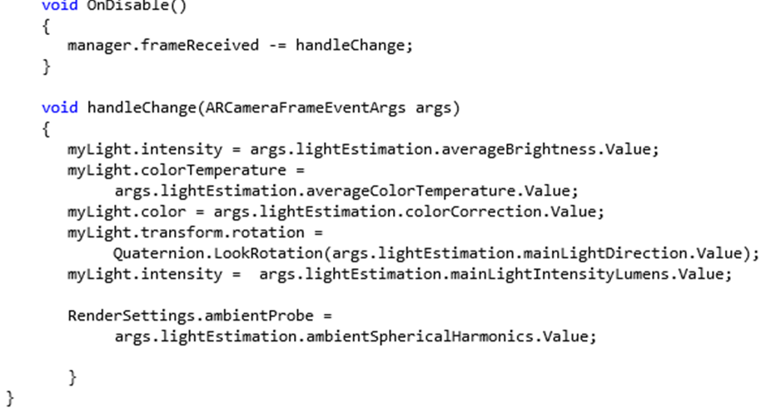
Light Estimation

Slide 51
Lets see how this works in Unity
The project is uploaded to the module as CTG v1.1.zip
Can use 01a – AR Project v1.1.docx as a step by step guide to produce the same results

Slide 52
Upcoming Important Events
This (aka week 1) Friday are the Presentations!
Week 2 Friday is an important workshop
To make sure you have something usable that is working on your devices
Week 3 – 1 Lecture with 2 supervisions
Deadline for Assignment 4 – 15th Jan 2023 by 23.59

